Slide 1
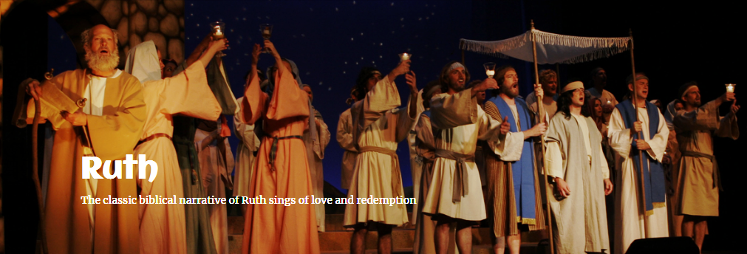
“RUTH”
Coming to the Groton Dunstable Performing Arts Center
September 15, 16, 22 and 23 @ 7:30 p.m. September 16, 17, 23 and 24 @ 2:30 p.m.
Tickets will go on sale some time in August.
http://www.newlifefinearts.org

